Slide 1
Evaporation flux ratio

Slide 2
Saturated vapor concentration

Slide 3
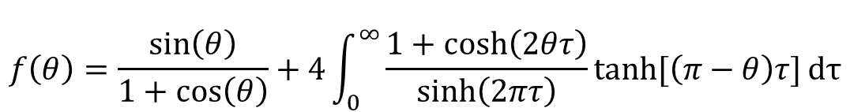
Contact angle function
$$f\left(θ\right)=\frac{sin\left(θ\right)}{1+cos\left(θ\right)}+4\int_{0}^{∞}{\frac{1+cosh\left(2θτ\right)}{sinh\left(2πτ\right)}tanh⁡[\left(π−θ\right)τ]}dτ$$

Slide 4






Evaporation flux at the spherical cap and droplet base
$${\dot{m}}_{1}$$
θ
$${\dot{m}}_{2}$$
$${\dot{m}}_{2}=2π{hR}^{ }D\left(c_{s2}−c_{∞}\right)/h$$
$${\dot{m}}_{1}=πRD\left(c_{s1}−c_{∞}\right)f\left(θ\right)$$
$${\dot{m}}_{2}=2πR^{2}D\left(c_{s2}−c_{∞}\right)/h$$
$${\dot{m}}_{2}=2πR^{2}D\left(c_{s2}−c_{∞}\right)/R$$

Slide 5
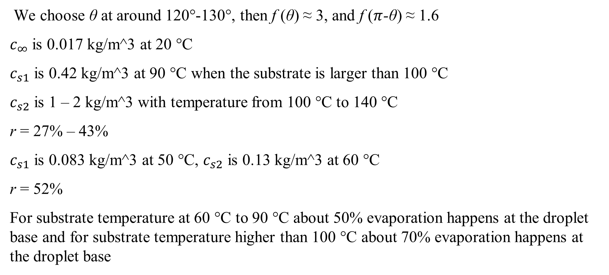
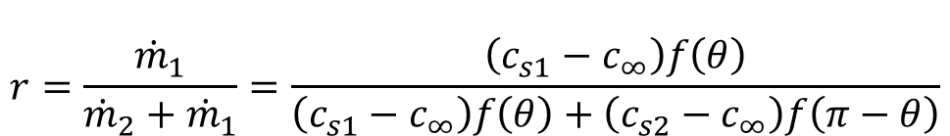
Evaporation flux ratio
$$r=\frac{{\dot{m}}_{1}}{{\dot{m}}_{2}+{\dot{m}}_{1}}=\frac{\left(c_{s1}−c_{∞}\right)f\left(θ\right)}{\left(c_{s1}−c_{∞}\right)f\left(θ\right)+\left(c_{s2}−c_{∞}\right)f\left(π−θ\right)}$$
We choose θ at around 120°-130°, then f (θ) ≈ 3, and f ($π$-θ) ≈ 1.6
$c_{∞}$ is 0.017 kg/m^3 at 20 °C
$c_{s1}$ is 0.42 kg/m^3 at 90 °C when the substrate is larger than 100 °C
$c_{s2}$ is 1 – 2 kg/m^3 with temperature from 100 °C to 140 °C
r = 27% – 43%
$c_{s1}$ is 0.083 kg/m^3 at 50 °C, $c_{s2}$ is 0.13 kg/m^3 at 60 °C
r = 52%
For substrate temperature at 60 °C to 90 °C about 50% evaporation happens at the droplet base and for substrate temperature higher than 100 °C about 70% evaporation happens at the droplet base

Slide 7







Average temperature at pillar top surface
We have the hot plate temperature T_{h}, thermal resistance of the pillar R_{p} and substrate R_{s}, heat flux calculated from the droplet volume change f.
Thus, we can obtain the average temperature at the pillar top surface:
Then, we can obtain the average temperature of the droplet base T₂
T₂ is around 94.5°C with the change of k
$$T1$$
$$kf$$
$$T2$$
$$T_{h}−T_{1}=f(R_{s}+R_{p})$$
$$f$$
$$T_{2}≈94.5 °C$$
$$Th$$

Slide 8




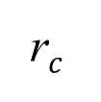

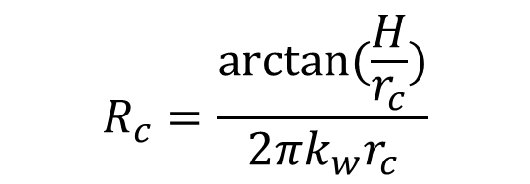

Conductive thermal resistance of water
$$T3$$
Droplet conductive thermal resistance:
$${\dot{m}}_{1}$$
$$R_{c}=\frac{arctan⁡(\frac{H}{r_{c}})}{2πk_{w}r_{c}}$$
$$H$$
$$(1−k)f$$
We can then obtain the droplet surface temperature
θ
$$T_{2}−T_{3}=\left(1−k\right)fR_{c}$$
r$c$
Due to the high temperature of the droplet surface, evaporation happens at the liquid vapor interface. Heat transfer due to the evaporation is calculated as:
$$T2$$
$$f_{e}=πr_{c}D\left(c_{s1}−c_{∞}\right)f\left(θ\right)/L$$
$$\left(1−k\right)f=f_{e}$$

Slide 9




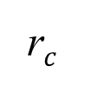



Droplet surface temperature
$$T3$$
$${\dot{m}}_{1}$$
$$T_{3}=70°C$$
$$H$$
$$(1−k)f$$
$$k=0.73$$
θ
r$c$
$$T2$$

Slide 10






Convection inside the droplet
Because of the large temperature difference between the droplet base and surface temperature, there will be Marangoni flow.
$$T3=70°C$$
$$Ra=\frac{gβ}{νD}(T_{s}−T_{b})d^{3}\sim {1×10}^{3}$$
$Ma=\frac{dγ}{dT_{b}}∙\frac{(T_{s}−T_{b})d}{μD}\sim {1×10}^{4}$
$Re=\frac{ud}{ν}\sim {1×10}^{3}$
$$T2=94.5°C$$
P$e=Re Pr\sim {2×10}^{3}$

Slide 11

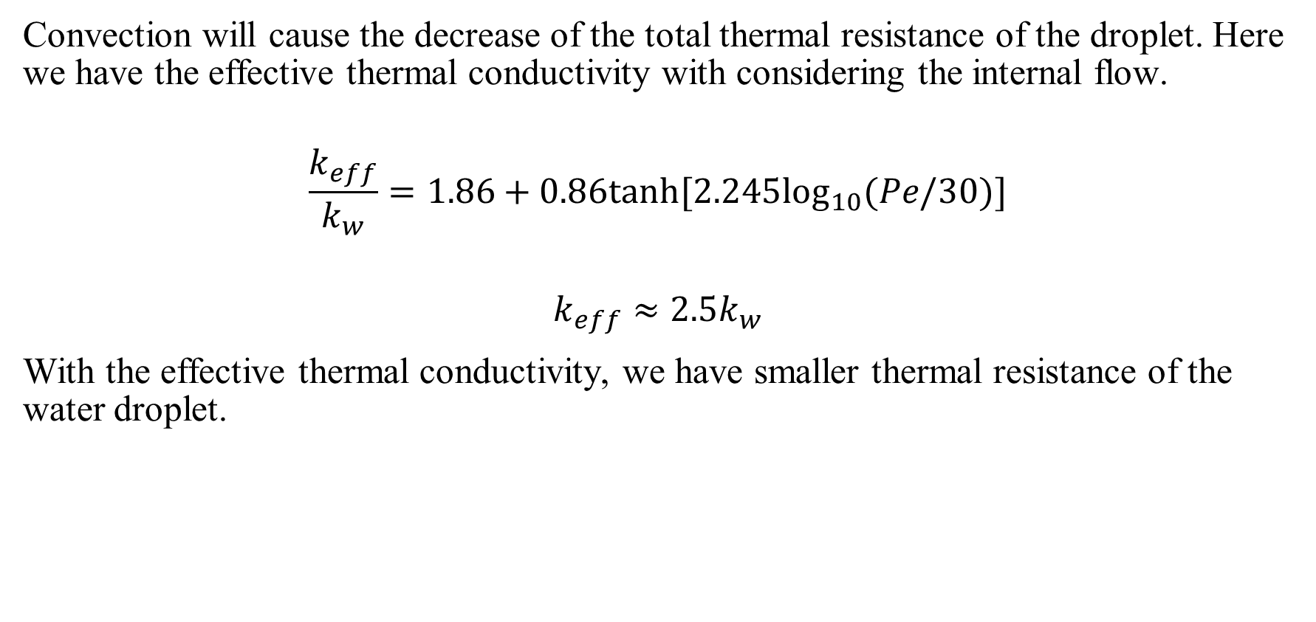


Effective thermal conductivity
Convection will cause the decrease of the total thermal resistance of the droplet. Here we have the effective thermal conductivity with considering the internal flow.
$$\frac{k_{eff}}{k_{w}}=1.86+0.86tanh⁡[2.245\log_{10}(Pe/30)]$$
$$k_{eff}≈2.5k_{w}$$
With the effective thermal conductivity, we have smaller thermal resistance of the water droplet.
$$R_{c}=\frac{arctan⁡(\frac{H}{r_{c}})}{2πk_{w}r_{c}}$$
$$T_{3}=80°C$$
$$k=0.61$$

Slide 12
